Slide 1
Imagine Other Possibilities:
Two to consider

Slide 4
Misuse of Taxpayer
Resources

Slide 5
Notes:
(Zoom in)
Cost estimates are staggering with 61% in contingencies applied
Private sector and other public sector jobs add contingencies of 5 to 10%
Lucas County Jail had 5% contingencies
Bridge spreadsheet
Bridges, most having been rebuilt in the past 20 years or less, and excessive costs to construct and remove

Slide 6
ODOT’s Cost Summary Estimate for Project
From May 2023 to now, Total Construction Costs increased from $178.4 million to $217.5 million or 22%
Includes neither costs for design nor for property acquisition
Construction costs include “30% Contingency” factored first
Then, “Escalation Factor” of 24.1% is added
Total ODOT pad to the Construction Costs is 61%
Other public and private sector capital contracts typically add 5% for contingencies

Slide 7
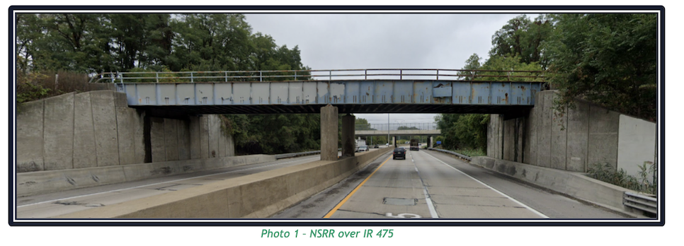
Norfolk-Southern Railroad Bridge Replacement: A gift from taxpayers
Single-track bridge
Generally used twice per month
Replacement cost at taxpayers’ expense to private corporation
At least $12.4 million or 11.3% of 2023 quoted construction budget

Slide 8
OH Disinvestment in Transportation Alternatives

Slide 9
Alternatives. A well-known OH disinvestment….
According to Policy Matters Ohio’s, citing a 2015 ODOT “Transit Needs Study”:
“Ohio policymakers have underfunded public transit for decades, routinely spending less than 1% of the state’s multi-billion-dollar transportation budget on public transit. In 2015, public transit across Ohio provided 115 million rides, 37.5 million less than market demand.”
In 2015, that Ohio Department of Transportation Study quantified what the state share should be — $150 million a year in 2015, rising to $185 million a year by 2025. Yet, in 2024 and 2025 combined, Ohio is allocating less than $124 million total, thwarting ODOT’s own anemic recommendations for public transit funding.
Source: Ohio Policy Matters. “Ohio Budget Guide, State Fiscal Years 2022-2023.” Accessed Feb 26, 2024. https://www.policymattersohio.org/files/research/2020budgetguide.pdf

Slide 10
Our Neighborhoods

Slide 11
Public Engagement Plan Community Demographics
The portion of I-475 included in this project is a predominately urban area on the west side of the city of Toledo. The area is surrounded predominately by residential properties along with commercial areas and open space. Census demographic data available in Transportation Information Mapping System (TIMS) shows that there are larger volumes of elderly populations (aged 65 and older) living in the areas surrounding the corridor; there are also some areas along the corridor with higher concentrations of lower income, linguistically isolated, and minority populations. All of these populations will be included in the public involvement process and appropriate means to communicate meeting and project information with them should be determined in consultation with local officials to ensure these groups receive this information.
Source: Public Engagement Plan. I-475 Improvement Project. LUC-475-10.21 (PID 115418). Ohio Department of Transportation, TranSystem. Aug 2022 (rev. Feb 2023). Page 5.

Slide 12
Our I-475 adjacent neighborhoods are the densest residential neighborhoods on the beltway
Over 6,700 residential households in the 5 sq. mi. ODOT-defined project area
Includes both single-family and multi-family residences

Slide 13
ODOT submitted this skewed neighborhood map to TRAC three times

Slide 14
ODOT’S SKEWED NEIGHBORHOOD DATA
ODOT used zoning classes-–NOT actual land use—for project area
“Spilled” commercial and institutional properties past pre-determined, ½ mile boundaries…
While eliminating residential properties which “spilled”
Calculated the pie chart based on properties which had “spilled”

Slide 15
Auditor’s office assisted us in determining actual land use
ODOT neglected to calculate as residential over 1,400 households (apartments and townhouses)
Despite Nov. 11 quote in The Blade from ODOT rep, not a single misclassified property we cite is mixed-use
All properties we included are strictly residential in use

Slide 16
Partial list of strictly residential, multi-family properties in ODOT-defined project area
West Park Place on Executive Parkway (205)
Secor Senior Lofts at corner of Secor and Monroe (108)
Georgetown Village on Middlesex Drive (305)
Jamestown Townhouses on Marvin near Wendover Avenues (204)
Garden Arms Apartments on Secor Road (132)
Oak Leaf Village on Holland-Sylvania Road (145)
Tamarack Creek Apartments on Secor Road (160)
Apartments in the multi-family residences just south of the expressway between Garrison and Woodmont Roads (134)
PARTIAL TOTAL OF ALL MULTI-FAMILY RESIDESDENTIAL HOUSEHOLDS IN ODOT DEFINE PROJECT AREA: 1,393

Slide 18
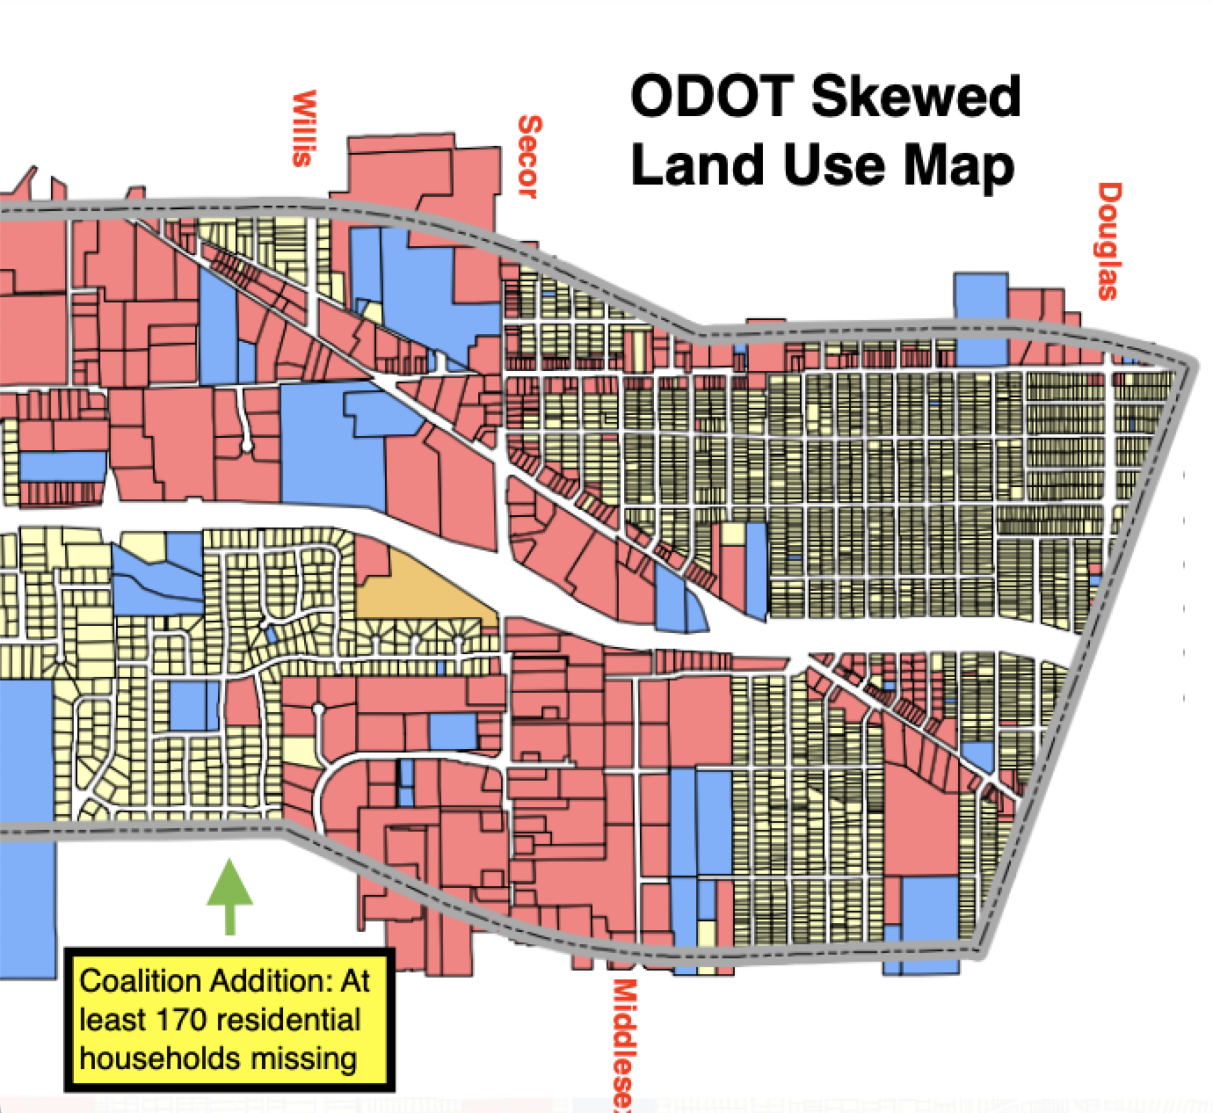
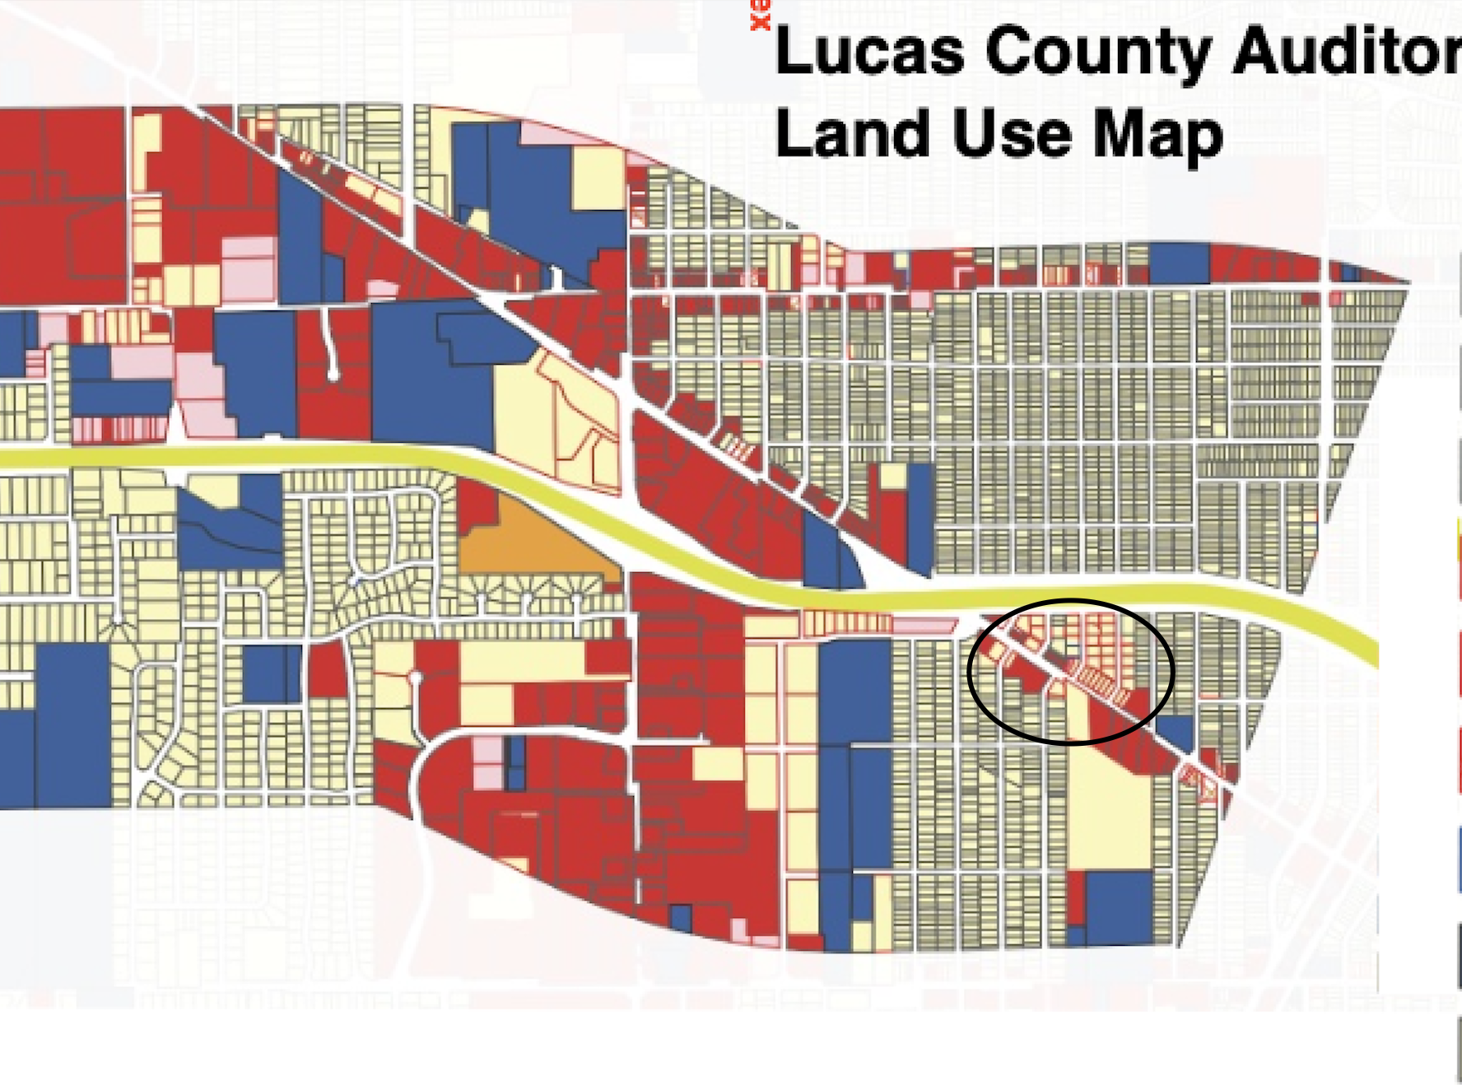

Slide 19
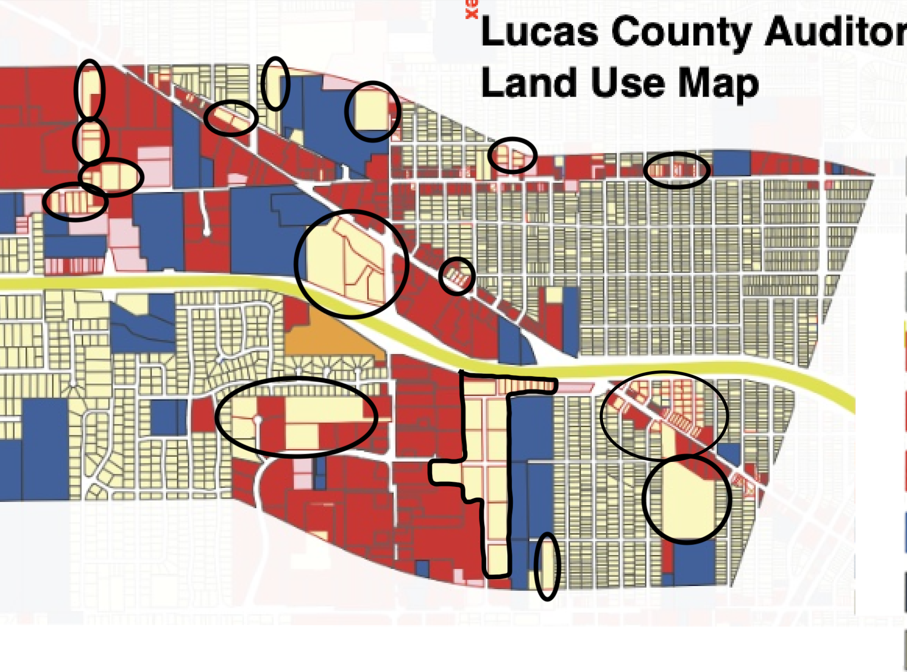

Slide 20
ALL RESIDENTS—whether single family, multi-family or in mixed-use housing-–are still RESIDENTS and must be considered
ODOT never seriously or sincerely considered ANY residents
With 6,700 residential households total in the project area, at 2.3 persons each, there are over 15,000 residents alone

Slide 21
There are REAL PEOPLE beyond residents in the project area every day at:
Schools
Nursing homes/assisted living facilities and hospitals
Childcare centers
Office and retail establishments
BOTTOM LINE
People are NOT considered by ODOT for harms
Only consideration is for vehicle-oriented, single-person commuters and long-haul truckers

Slide 22
Collective investment of residents
Auditor’s Office instrumental arriving at a true picture of the neighborhoods
Recent re-evaluation of property values for this moment in time
Investment by those who live in ODOT’s 5 sq. mi. project area:
Single-family residential properties – 4,078
Multi-family properties– 116 (none are mixed use, but are apartment buildings (both small and large) and complexes with townhomes
Exempted properties converted from single-family residential: 14
COLLECTIVE APPRAISED VALUATION CURRENTLY: $870,517,600
COLLECTIVE MARKET VALUE: More than $1 Billion???

Slide 24
CONGESTION

Slide 30
WTVG’s Shaun Hegarty, 6:00 pm live report, afternoon rush hour, Jun 2, 2023

Slide 33
Source: Civil Engineering Discoveries Linkedin, June 2023
https://www.linkedin.com/posts/civilengineeringdiscoveries_the-katy-freeway-the-katy-freeway-in-houston-activity-7073363435509432320-KEAJ

Slide 34
“Because if there’s anything that traffic engineers have discovered in the last few decades it’s that you can’t build your way out of congestion. It’s the roads themselves that cause traffic.”
Adam Mann
“What’s Up With That: Building Bigger Roads Actually Makes Traffic Worse”
Wired.com
June 17, 2014

Slide 35
“Adding car lanes to deal with traffic congestion is like loosening your belt to cure obesity.”
– Lewis Mumford, 1955

Slide 37
Questions: Who is this project for?
How can it be for the sharply declining Lucas County population?
How much trucking traffic is ODOT projecting after opening the Gordie Howe Bridge?
Is Commerce the only thing to consider here?
Is Commerce at ALL COSTS good for our health, our community resources, our property values?
Where is the balance? How much is too much?

Slide 38
SAFETY

Slide 39
Without any context, ODOT consistently reports 2 fatalities in project segment in period between 2019-2021 :
Both involved occupants not wearing seat belts
Both involved vehicles which left the roadway
One involved a young driver (ages 15-25)
NEITHER of these crashes would have been prevented with an expanded highway.

Slide 40
Without context, ODOT consistently reports 4 serious-injury crashes in project segment in period between 2019-2021 :
Three of the four injury crashes involved speeding
Three involved a young driver (ages 15-25)
Three involved vehicles which left the roadway
One injury crash involved alcohol
One involved a motorcycle
One involved an occupant not wearing a seatbelt
NONE of these crashes would have been prevented with an expanded highway.

Slide 41
ODOT claims length and curvature of ramps are deficient on existing expressway.
Compare…

Slide 42
Talmadge Road On Ramp –
Length of +/- 1,225 ft., with 700 ft. straightaway onto highway, versus…

Slide 43
I-475 West Interchange with US-23 South –
ODOT reconfigured interchange within the last 10 years.
At highway speeds of 60-65 MPH on both highways, Westbound I-475 traffic has just 990 ft. to access Central Avenue Exit, inside a major curve, while merging with southbound US-23 traffic.
All at the same time.

Slide 44
Risks and Harms to the Neighborhoods… Already

Slide 49
ODOT Snubbed Neighborhood Residents…and Continues to Exclude Us To This Day

Slide 50
ODOT’s own consulting engineers, Mannik & Smith, warned them that neighborhoods should be involved.
“Because of the opposition heard during the first phase of public involvement, it will be important to be open and transparent with the public throughout the I-475 Improvement Project (LUC-475-10.20, PID 115418), taking into account the public’s concerns and explaining the reasoning behind the decisions being made.”
ODOT ignored the recommendation and continues to do so.

Slide 51
ODOT committed to Newsletters they never produced
“Newsletter: Newsletters with updates on the LUC-475-10.21 project will be developed by the consultant team as there are project updates available to share. Up to eight quarterly newsletters will be distributed to the public and stakeholders throughout the project and will also be made available on the project website. Newsletters may be provided in additional languages depending on the need.”
Source: Public Engagement Plan, I-475 Improvement Project, LUC-475-10.21 (PID 115418). TranSystems for Ohio Department of Transportation. Feb 2023

Slide 52
ODOT Project Newsletter, Volume 1, Spring 2023 – Never distributed to any neighbor—only to “stakeholders”
As the Ohio Department of Transportation’s District 2 Deputy Director, I want to welcome you to the first newsletter for the Proposed I-475 East/West Improvement Project. On behalf of our project team, it is our sincere commitment to you that we will be engaging and informative throughout the life of this study. We will be sharing information to keep you updated, seeking your feedback, listening to your concerns, and answering your questions throughout the project development process. In this regard, information on how to find out more about the project and how to stay connected with the project team can be found in this newsletter and on the project’s website. We encourage you to sign up to receive future newsletters and public notices.
Respectfully, Pat McColley, P.E., S.I. District Deputy Director
Source: I-475 East/West Improvement Project, LUC-IR475-10.21 Widening (PID 115418), Volume 1, Spring 2023.

Slide 53
Resolutions to oppose highway expansions
Minneapolis, MN—2020 through 2024—Consistent unanimous votes by 12-member City Council
Jersey City, NJ—July 2024—Unanimous 9-0 City Council vote
Fitchburg, WI, Common Council—June 2024—Unanimous 8-0 City Council vote
Ann Arbor, MI Ann Arbor, MI—March 2024—Unanimous 11-0 City Council vote
Albany, NY Albany, NY—January 2024—Unanimous 15-0 City Council vote
Ohio County, IN, Board of Commissioners—October 2023—Unanimous 3-0 County Commissioners vote
Austin, TX—October 2023—7 to 3 City Council vote
Southeast Los Angeles—May 2022—Unanimous vote by Los Angeles County Metropolitan Transportation Authority
Hoboken, NJ, City Council—August 2022—Unanimous 8-0 City Council vote.
St. Paul, MN—February 2021—Unanimous 7-0 City Council vote
Travis County, TX, County Commissioners Court—September 2023—Unanimous 5-0 Joint letter asking TXDOT to address all previously submitted concerns before moving forward I-35 Capital Express Central

